Slide 1
Learning Objective
CFU
What will we learn today?
CFU
I will be able to solve trigonometric equations
How will you know that you are successful?
Success Criteria
At the end of the lesson, I will be able to:
recall the graphing of trigonometric functions;
use the graph of a trigonometric functions to solve a simple equation by looking for intersection points;
recall the exact values and reference angles in a unit circle to generate the values;
solve trigonometric equations over a given domain, using the reference angle method;
recognise that a change in period represents a change in domain when solving a trigonometric equation; and
solve trigonometric equations graphically or using the CAS ClassPad.

Slide 2
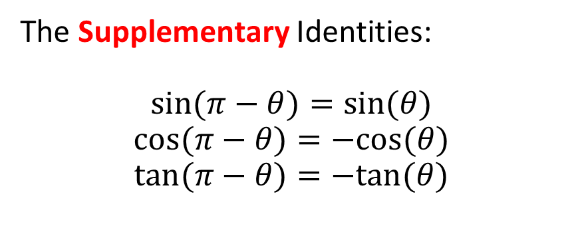
Concept Development
The Supplementary Identities:
$$\sin{(π}−θ)=sin⁡(θ)$$
$$\cos{(π}−θ)=−cos⁡(θ)$$
$$\tan{(π}−θ)=−tan⁡(θ)$$

Slide 3
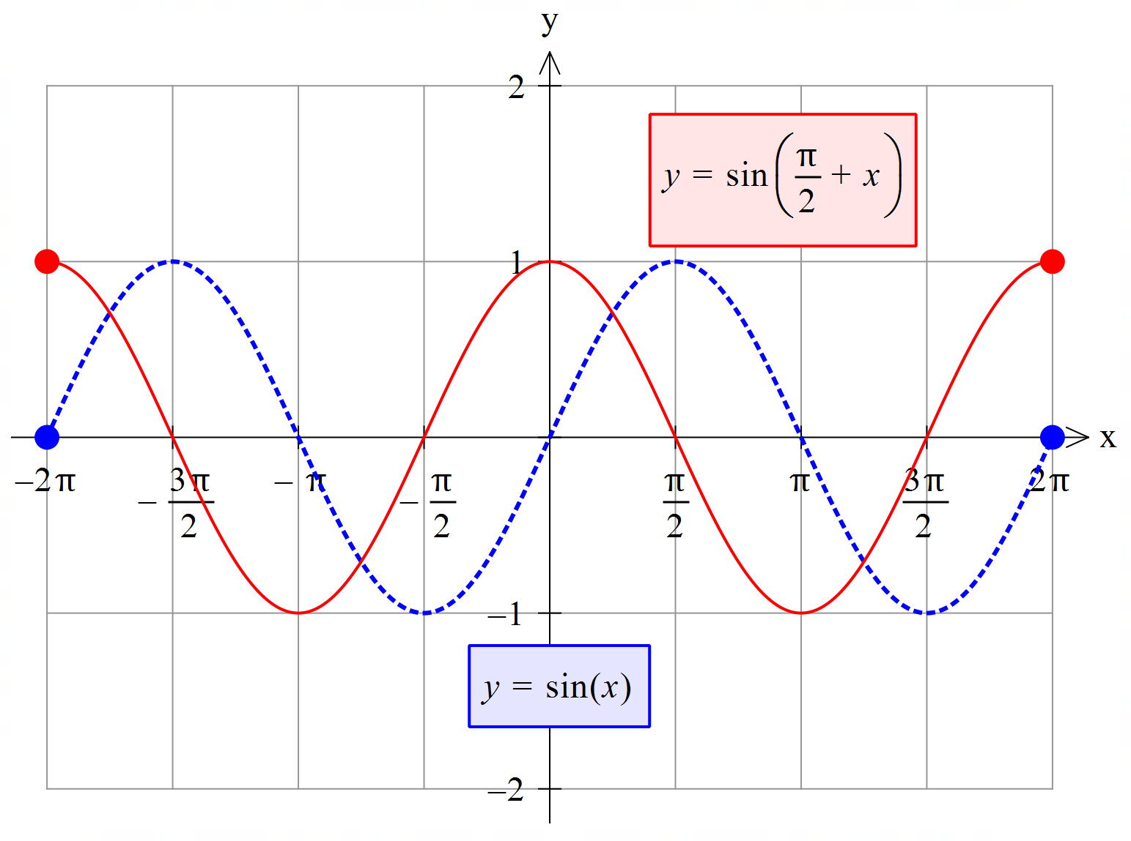
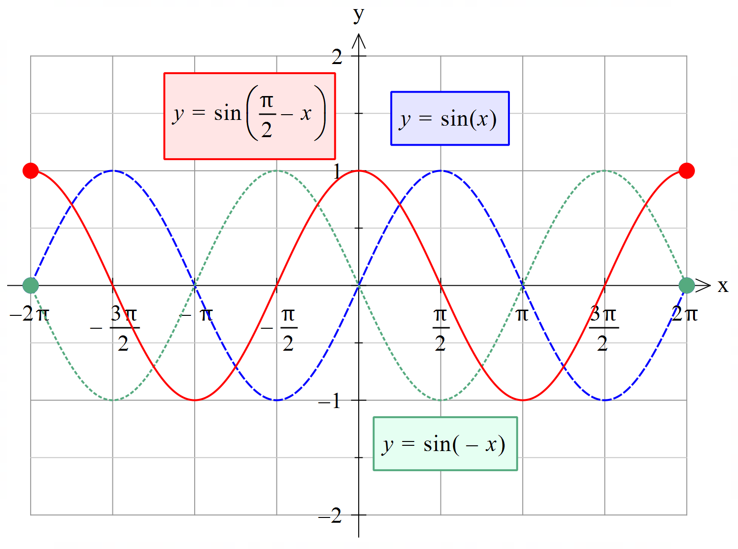
Concept Development
The Complementary Identities:
$$sin\left(\frac{π}{2}+θ\right)=cos⁡(θ)$$
$$sin\left(\frac{π}{2}−θ\right)=cos⁡(θ)$$
$$cos\left(\frac{π}{2}−θ\right)=sin\left(θ\right)$$
$$cos\left(\frac{π}{2}+θ\right)=−sin(θ)$$

Slide 4
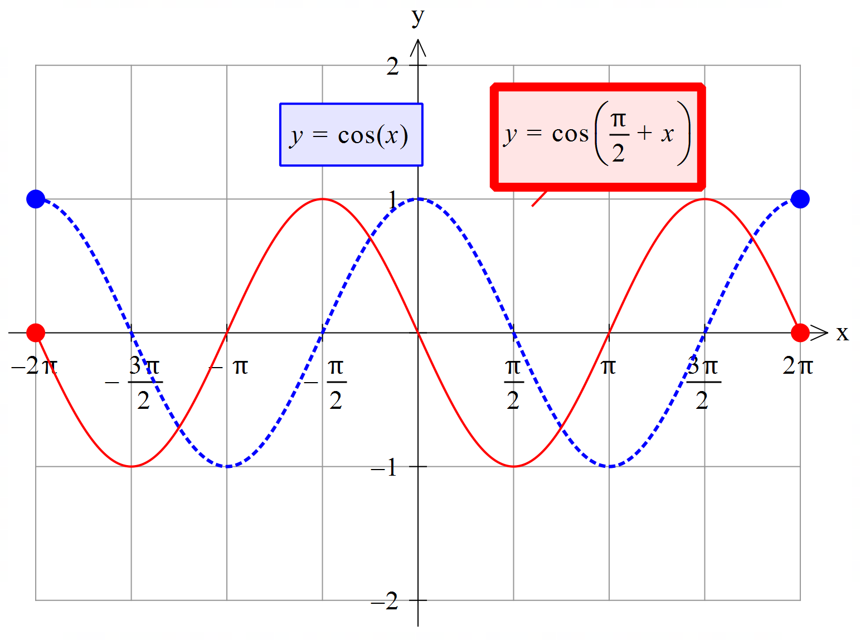
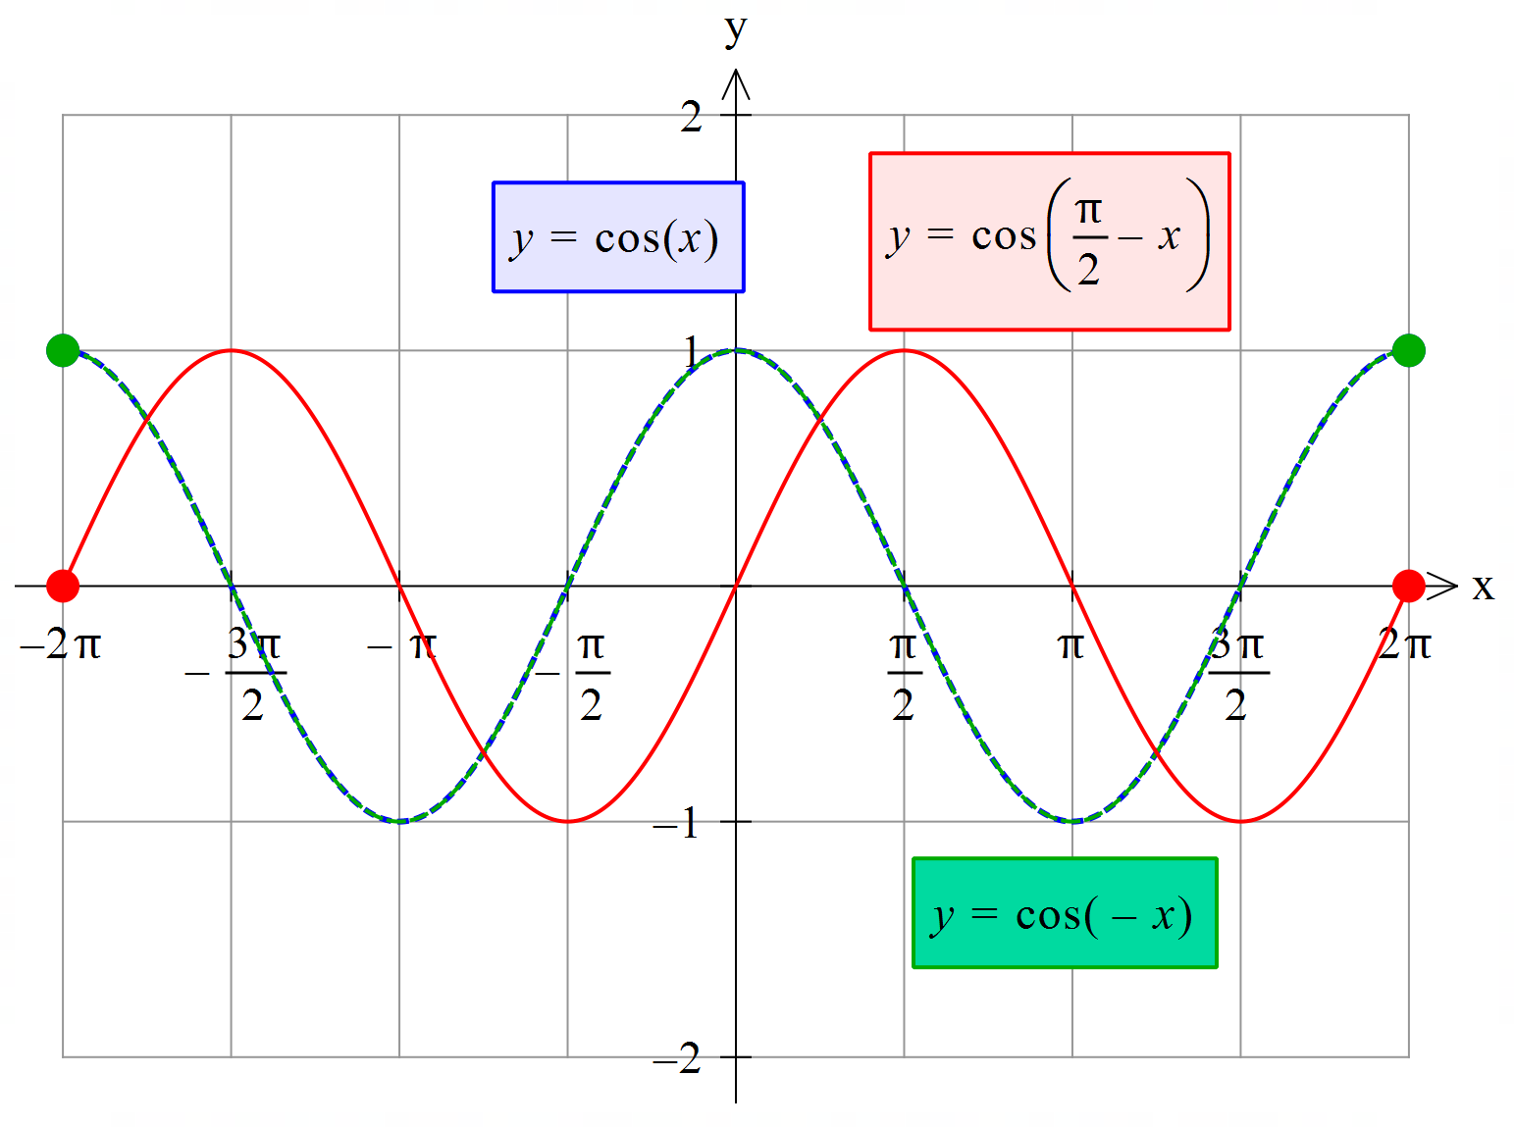
Concept Development
The Complementary Identities:
$$sin\left(\frac{π}{2}+θ\right)=cos⁡(θ)$$
$$sin\left(\frac{π}{2}−θ\right)=cos⁡(θ)$$
$$cos\left(\frac{π}{2}+θ\right)=−sin\left(θ\right)$$
$$cos\left(\frac{π}{2}−θ\right)=sin\left(θ\right)$$

Slide 5


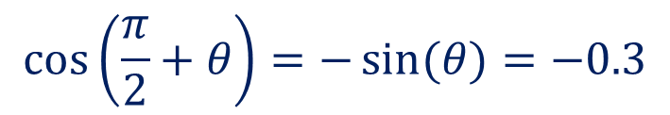
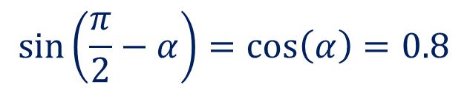
Guided Practice
If $\sin\left(θ\right)=0.3 and\cos\left(α\right)=0.8,$ find the values of:
a) $\sin\left(\frac{π}{2}−α\right)$
b) $\cos\left(\frac{π}{2}+θ\right)$
c) $\sin\left(−θ\right)$
$$\sin\left(\frac{π}{2}−α\right)=\cos\left(α\right)=0.8$$
$$\cos\left(\frac{π}{2}+θ\right)=−\sin{(θ})=−0.3$$
$$\sin{(−θ})=−\sin\left(θ\right)=−0.3$$

Slide 6




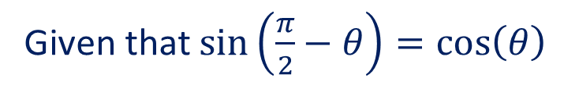
Guided Practice
Given that $0<θ<\frac{π}{2} and\cos\left(θ\right)=\sin\left(\frac{π}{6}\right),$ find the values of $θ$:
Given that $\sin\left(\frac{π}{2}−θ\right)=\cos\left(θ\right)$
$$\frac{π}{2}−θ=\frac{π}{6}$$
$$θ=\frac{π}{2}−\frac{π}{6}$$
$$θ=\frac{3π}{6}−\frac{π}{6}=\frac{π}{3}$$

Slide 7
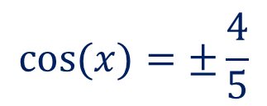

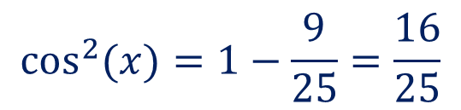
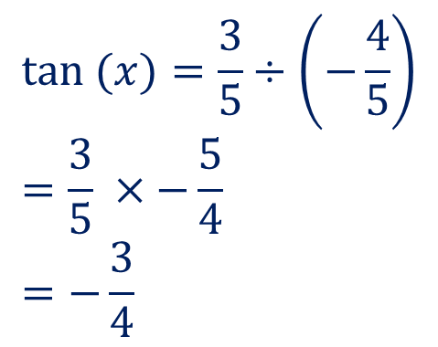
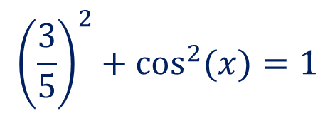
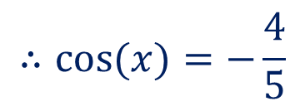

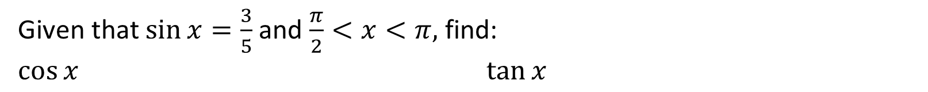
Concept Development
The Pythagorean Identity:
$$\sin^{2}{θ}+\cos^{2}{θ}=1$$
Given that $\sin{x}=\frac{3}{5}$ and $\frac{π}{2}<x<π,$ find:
$$\cos{x} \tan{x}$$
$$\sin^{2}\left(x\right)+\cos^{2}{(x)}=1$$
$$\tan{(x)}=\frac{3}{5}÷\left(−\frac{4}{5}\right) \\ =\frac{3}{5} ×−\frac{5}{4} \\ =−\frac{3}{4}$$
$${\left(\frac{3}{5}\right)}^{2}+\cos^{2}{(x)}=1$$
$$\cos^{2}{(x)}=1−\frac{9}{25}=\frac{16}{25}$$
$$\cos{(x)}=±\frac{4}{5}$$
$$∴cos{(x)}=−\frac{4}{5}$$

Slide 8
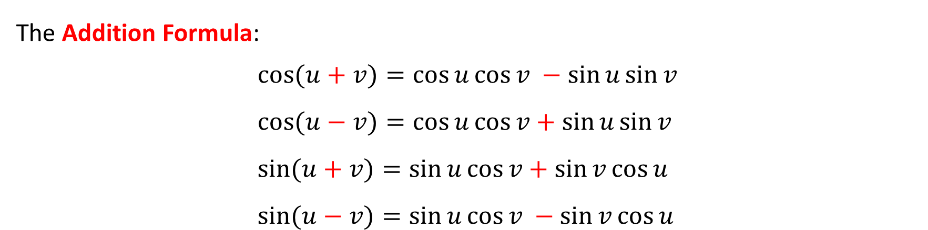
Concept Development
The Addition Formula:
$$\cos{(u+v)}=\cos{u}\cos{v} −\sin{u}\sin{v} \\ \cos{(u−v)}=\cos{u}\cos{v}+\sin{u}\sin{v} \\ \sin{(u+v)}=\sin{u}\cos{v}+\sin{v}\cos{u} \\ \sin{(u−v})=\sin{u}\cos{v }−\sin{v}\cos{u}$$

Slide 9

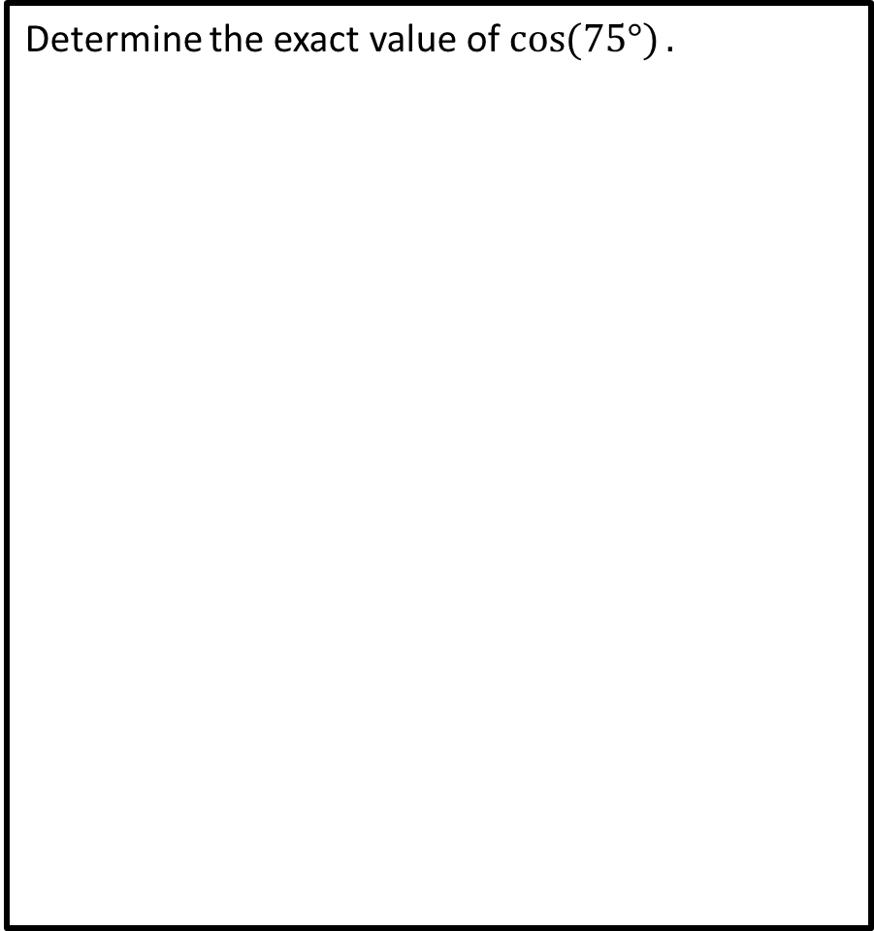

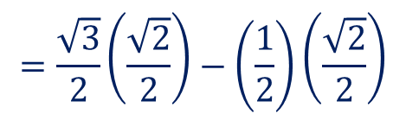


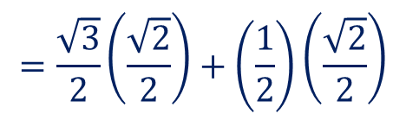


Guided Practice
Determine the exact value of $\cos{(75°)}.$
Determine the exact value of cos(15°).
$$\cos\left(75°\right)=\cos{(30+45)}$$
$$\cos\left(15°\right)=\cos{(45−30)}$$
$$=\cos\left(30\right)\cos{(45)}−\sin\left(30\right)\sin{(45)}$$
$$=\cos\left(45\right)\cos{(30)}+\sin\left(45\right)\sin{(30)}$$
$$=\frac{\sqrt{3}}{2}\left(\frac{\sqrt{2}}{2}\right)−\left(\frac{1}{2}\right)\left(\frac{\sqrt{2}}{2}\right)$$
$$=\frac{\sqrt{3}}{2}\left(\frac{\sqrt{2}}{2}\right)+\left(\frac{1}{2}\right)\left(\frac{\sqrt{2}}{2}\right)$$
$$=\frac{\sqrt{6}−\sqrt{2}}{4}$$
$$=\frac{\sqrt{6}+\sqrt{2}}{4}$$

Slide 10




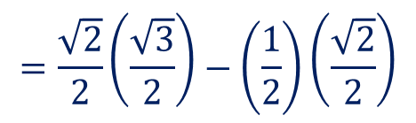


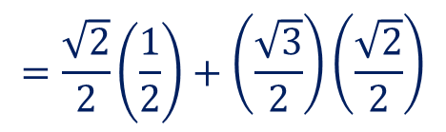
Guided Practice
Determine the exact value of sin(15°).
Determine the exact value of sin(105°).
$$\sin\left(15°\right)=\sin{(45−30)}$$
$$\sin\left(105°\right)=\sin{(45+60)}$$
$$=\sin\left(45\right)\cos{(30)}−\sin\left(30\right)\cos{(45)}$$
$$=\sin\left(45\right)\cos{(60)}+\sin\left(60\right)\cos{(45)}$$
$$=\frac{\sqrt{2}}{2}\left(\frac{\sqrt{3}}{2}\right)−\left(\frac{1}{2}\right)\left(\frac{\sqrt{2}}{2}\right)$$
$$=\frac{\sqrt{2}}{2}\left(\frac{1}{2}\right)+\left(\frac{\sqrt{3}}{2}\right)\left(\frac{\sqrt{2}}{2}\right)$$
$$=\frac{\sqrt{6}−\sqrt{2}}{4}$$
$$=\frac{\sqrt{2}+\sqrt{6}}{4}$$

Slide 11
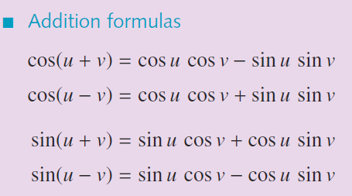
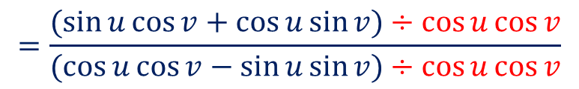
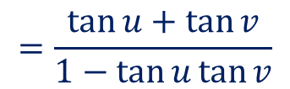

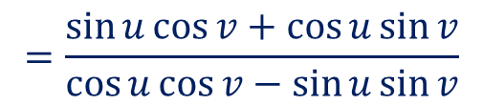
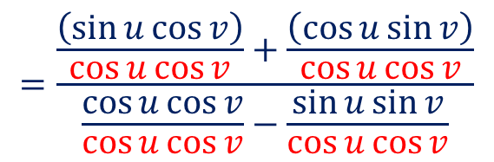
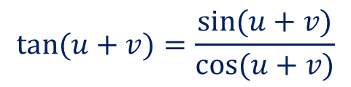
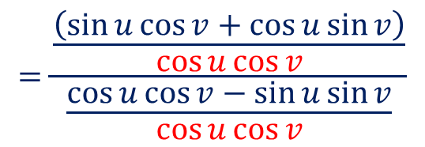
The Tangent Angle Addition Identity
Guided Practice
Proof $\tan{(u+v)}=\frac{\tan{u}+\tan{v}}{1−\tan{u}\tan{v}}$
NOT IN FORMULA SHEET
$$\text{tan}⁡(u+v)=\frac{\sin{(u+v)}}{\cos{(u+v)}}$$
$$=\frac{\sin{u}\cos{v}+\cos{u}\sin{v}}{\cos{u}\cos{v}−\sin{u}\sin{v}}$$
Divide the numerator by $\cos{u}\cos{v}$
$$=\frac{(\sin{u}\cos{v}+\cos{u}\sin{v})÷\cos{u}\cos{v}}{(\cos{u}\cos{v}−\sin{u}\sin{v})÷\cos{u}\cos{v}}$$
$$=\frac{\frac{\left(\sin{u}\cos{v}+\cos{u}\sin{v}\right)}{\cos{u}\cos{v}}}{\frac{\cos{u}\cos{v}−\sin{u}\sin{v}}{\cos{u}\cos{v}}}$$
$$=\frac{\frac{\left(\sin{u}\cos{v}\right)}{\cos{u}\cos{v}}+\frac{\left(\cos{u}\sin{v}\right)}{\cos{u}\cos{v}}}{\frac{\cos{u}\cos{v}}{\cos{u}\cos{v}}−\frac{\sin{u}\sin{v}}{\cos{u}\cos{v}}}$$
$$=\frac{\tan{u}+\tan{v}}{1−\tan{u}\tan{v}}$$

Slide 12
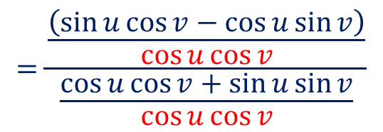
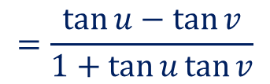
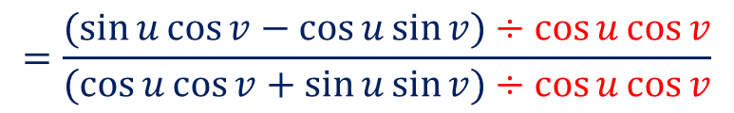
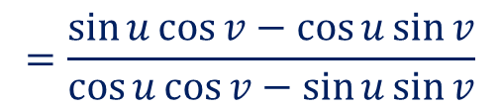

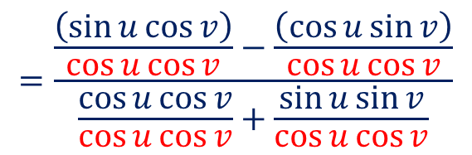
The Tangent Angle Addition Identity
Guided Practice
Proof $\tan{(u−v)}=\frac{\tan{u}−\tan{v}}{1+\tan{u}\tan{v}}$
NOT IN FORMULA SHEET
$$\text{tan}⁡(u−v)=\frac{\sin{(u−v)}}{\cos{(u−v)}}$$
$$=\frac{\sin{u}\cos{v}−\cos{u}\sin{v}}{\cos{u}\cos{v}−\sin{u}\sin{v}}$$
Divide the numerator by $\cos{u}\cos{v}$
$$=\frac{(\sin{u}\cos{v}−\cos{u}\sin{v})÷\cos{u}\cos{v}}{(\cos{u}\cos{v}+\sin{u}\sin{v})÷\cos{u}\cos{v}}$$
$$=\frac{\frac{\left(\sin{u}\cos{v}−\cos{u}\sin{v}\right)}{\cos{u}\cos{v}}}{\frac{\cos{u}\cos{v}+\sin{u}\sin{v}}{\cos{u}\cos{v}}}$$
$$=\frac{\frac{\left(\sin{u}\cos{v}\right)}{\cos{u}\cos{v}}−\frac{\left(\cos{u}\sin{v}\right)}{\cos{u}\cos{v}}}{\frac{\cos{u}\cos{v}}{\cos{u}\cos{v}}+\frac{\sin{u}\sin{v}}{\cos{u}\cos{v}}}$$
$$=\frac{\tan{u}−\tan{v}}{1+\tan{u}\tan{v}}$$

Slide 13







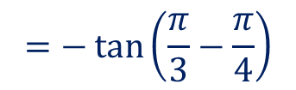











Guided Practice
Determine the exact value of tan(75°).
Determine the exact value of $\tan\left(−\frac{π}{12}\right)$
$$\tan\left(75\right)=\tan{(30+45)}$$
$$\tan\left(−\frac{π}{12}\right)=−tan{(\frac{π}{12})}$$
$$=\frac{\tan{30}+\tan{45}}{1−\tan{30}\tan{45}}$$
$$=−\tan\left(\frac{4π}{12}−\frac{3π}{12}\right)$$
$$=\frac{\left(\frac{1}{\sqrt{3}}+1\right)}{1−\frac{1}{\sqrt{3}}}$$
$$=−\tan\left(\frac{π}{3}−\frac{π}{4}\right)$$
$$=−\frac{\tan{\frac{π}{3}}−\tan{\frac{π}{4}}}{1+\tan{\frac{π}{3}}\tan{\frac{π}{4}}}$$
$$=\frac{\sqrt{3}+1}{\sqrt{3}}÷\frac{\sqrt{3}−1}{\sqrt{3}}$$
$$=−\frac{2(\sqrt{3}−2)}{−2}$$
$$=−\frac{\sqrt{3}−1}{1+\sqrt{3}}$$
$$=\frac{1+2\sqrt{3}+3}{2}$$
$$=\frac{\sqrt{3}+1}{\sqrt{3}−1}$$
$$=\sqrt{3}−2$$
$$=\frac{2(2+\sqrt{3})}{2}$$
$$=−\frac{\sqrt{3}−1}{1+\sqrt{3}}×\frac{1−\sqrt{3}}{1−\sqrt{3}}$$
$$=\frac{\sqrt{3}+1}{\sqrt{3}−1}×\frac{\sqrt{3}+1}{\sqrt{3}+1}$$
$$=2+\sqrt{3}$$
$$=−\frac{2\sqrt{3}−4}{−2}$$

Slide 14









Express the following trig functions in terms of sin(x) and cos(x)
Guided Practice
$$y=9sin⁡\left(x−\frac{π}{4}\right)$$
$$y=−5cos\left(x+\frac{2π}{3}\right)$$
$$=9\left[\sin\left(x\right)\cos\left(\frac{π}{4}\right)−\sin\left(\frac{π}{4}\right)\cos\left(x\right)\right]$$
$$=−5\left[\cos\left(x\right)\cos\left(\frac{2π}{3}\right)−\sin\left(x\right)\sin\left(\frac{2π}{3}\right)\right]$$
$$=9\left[\frac{\sin\left(x\right)\sqrt{2}}{2}−\frac{\sqrt{2}\cos\left(x\right)}{2}\right]$$
$$=−5\left[−cos\left(x\right)\cos\left(\frac{π}{3}\right)−\sin\left(x\right)\sin\left(\frac{π}{3}\right)\right]$$
$$=5\left[\cos\left(x\right)\left(\frac{1}{2}\right)+\sin\left(x\right)\left(\frac{\sqrt{3}}{2}\right)\right]$$
$$=\frac{9\sqrt{2}}{2}\left[\sin\left(x\right)−cos⁡(x)\right]$$
$$=\frac{5}{2}\left[\cos\left(x\right)+\sqrt{3}sin\left(x\right)\right]$$

Slide 15






EXAMPLE (Right-Angled Trig): Given that X and Y are acute angles,
Guided Practice
(a) Draw two right angled triangles to represent the following:
$$\sin\left(X\right)= \frac{8}{17}$$
$$\tan\left(Y\right)= \frac{3}{4}$$
(b) Hence, determine the exact value of $cos⁡(X − Y)$.
$$=\cos\left(X\right)\cos\left(Y\right)+\sin\left(X\right)sin⁡(Y)$$
$$=\left(\frac{15}{17}\right)\left(\frac{4}{5}\right)+\left(\frac{8}{17}\right)\left(\frac{3}{5}\right)$$
$$=\frac{60}{85}+\frac{24}{85}$$
$$=\frac{84}{85}$$

Slide 16






If $u$ and $v$ are acute angles, such that $\tan{u=4}$and $\tan{v}=\frac{3}{5}$, show that $u−v=\frac{π}{4}$
Guided Practice
$$\tan\left(u−v\right)=\frac{\tan{u}−\tan{v}}{1+\tan{u}\tan{v}}$$
$$=\frac{4−\frac{3}{5}}{1+4\left(\frac{3}{5}\right)}$$
$$=\frac{\frac{17}{5}}{1+\frac{12}{5}}$$
$$=\frac{17}{5}÷\left(\frac{17}{5}\right)$$
$$tan⁡(u−v)=1$$
$$∴u−v=\frac{π}{4}$$

Slide 17






If $sinα=\frac{3}{5}$ and $\sin{β}=\frac{24}{25}$, with $\frac{π}{2}<β<α<π ,$ evaluate $\sin{(α−β)}$
Guided Practice
$$\sin{(α−β)}=\sin{(α)}\cos{(β)}−\sin\left(β\right)\cos{(α})$$
$$=\left(\frac{3}{5}\right)\left(−\frac{7}{25}\right)−\left(\frac{24}{25}\right)\left(−\frac{4}{5}\right)$$
$$=−\frac{21}{125}+\frac{96}{125}$$
$$\cos\left(α\right)=−\frac{4}{5}$$
$$\cos\left(β\right)=−\frac{7}{25}$$
$$=\frac{75}{125}$$
$$=\frac{3}{5}$$

Slide 18












If $\tan{θ}=\frac{4}{3}$ and $0<θ<\frac{π}{2} ,$ evaluate $\sin\left(2θ\right) and \tan\left(2θ\right)$
Guided Practice
$$\sin{(2θ)}=\sin{(θ+θ)}$$
$$=\sin{θ}\cos{θ}+\sin{θ}\cos{θ}$$
$$=2sin{θ}\cos{θ}$$
$$\tan{(2θ)}=\tan{(θ+θ)}$$
$$=2\left(\frac{4}{5}\right)\left(\frac{3}{5}\right)$$
$$=\frac{\tan{θ}+\tan{θ}}{1−\tan{θ}\tan{θ}}$$
$$=\frac{24}{25}$$
$$=\frac{2tan{θ}}{1−{\left(\tan{θ}\right)}^{2}}$$
$$=\frac{2\left(\frac{4}{3}\right)}{1−{\left(\frac{4}{3}\right)}^{2}}$$
$$=\frac{\frac{8}{3}}{1−\frac{16}{9}}$$
$$=\frac{\frac{8}{3}}{−\frac{7}{9}}$$
$$=−\frac{24}{7}$$

Slide 19



Simplify ${\left(\sin{θ}−\cos{θ}\right)}^{2}$
Guided Practice
$$=\sin^{2}{θ−2\sin{θ}\cos{θ}+\cos^{2}{θ}}$$
$$=\sin^{2}{θ+\cos^{2}{θ}−2\sin{θ}\cos{θ}}$$
$$=1−2\sin{θ}\cos{θ}$$

Slide 20


Simplify $\cos^{4}{θ}−\sin^{4}{θ}$
Guided Practice
$$=(\cos^{2}{θ}−\sin^{2}{θ})(\cos^{2}{θ}+\sin^{2}{θ})$$
$$=\cos^{2}{θ}−\sin^{2}{θ}$$

Slide 21








Solve the following trigonometric equations.
Guided Practice
$\cos\left(x+\frac{π}{4}\right)=\frac{\sqrt{3}}{2}$ ,$0≤x≤2π$
$$\frac{π}{4}≤x+\frac{π}{4}≤\frac{9π}{4}$$
$$x+\frac{π}{4}=\frac{11π}{6},\frac{13π}{6}$$
$$x=\frac{11π}{6}−\frac{π}{4},\frac{13π}{6}−\frac{π}{4}$$
$$x=\frac{19π}{12},\frac{23π}{12}$$

Slide 22






Solve the following trigonometric equations.
Guided Practice
$$\frac{\sin{x}}{\cos{x}}=\sqrt{3}$$
$$\tan{x}=\sqrt{3}$$
$$x=−\frac{2π}{3},\frac{π}{3}$$

Slide 23









Solve the following trigonometric equations.
Guided Practice
(HCF FACTORISATION & NULL FACTOR LAW)
$$\sin{(2x})\left(\cos\left(x\right)−\frac{1}{\sqrt{2}}\right)=0$$
$$\cos\left(x\right)−\frac{1}{\sqrt{2}} =0$$
$$\sin{(2x}) =0$$
$$−360≤2x≤360$$
$$2x=−360,−180,0,180,360$$
$$\cos\left(x\right)=\frac{1}{\sqrt{2}}$$
$$x=−180,−90,0,90,180$$
$$x=−45°,45$$
$$x=−180°,−90°,−45°,0°,45°,90°,180°$$

Slide 24












Solve the following trigonometric equations.
Guided Practice
(QUADRATIC FACTORISATION)
Let $y=sin{x}$
$$\sin{x}=\frac{1}{2}, \sin{x}=1$$
$$y^{2}−\frac{3}{2}y+\frac{1}{2}=0$$
$$x=\frac{π}{6},\frac{5π}{6}$$
$$x=\frac{π}{2}$$
$$2y^{2}−3y+1=0$$
$$2y^{2}−2y−y+1=0$$
$$x=\frac{π}{6},\frac{π}{2},\frac{5π}{6}$$
$$2y\left(y−1\right)−(y−1)=0$$
$$\left(2y−1\right)\left(y−1\right)=0$$
$$y=\frac{1}{2}, y=1$$

Slide 25









Solve the following trigonometric equations.
Guided Practice
(PYTHAGOREAN)
$$\left(1−\cos^{2}{x}\right)+\cos{x}=1$$
$$−\cos^{2}{x}+\cos{x}+1=1$$
$$\cos^{2}{x}−\cos{x}=0$$
$$\cos{x}\left(\cos{x}−1\right)=0$$
$$\cos{x}=0, \cos{x}=1$$
$$x=\frac{π}{2},\frac{3π}{2},−\frac{π}{2},−\frac{3π}{2}$$
$$x=−2π, 0,2π$$
$$x=−2π,−\frac{3π}{2},−\frac{π}{2},0,\frac{π}{2},\frac{3π}{2}$$

Slide 26





Solve the following trigonometric equations.
Guided Practice
(REVERSE ANGLE SUM & DIFFERENCE)
$$\cos{60}°\cos{x}−\sin{60°}\sin{x}=−1$$
$$\cos{(x+60°)}=−1$$
$$60≤x+60≤420°$$
$$x+60°=180°$$
$$x=120°$$

Slide 27








Concept Development (Optional)
Prove: $\cos{(u−v)}=\cos{u}\cos{v} −\sin{u}\sin{v}$
$BC^{2}={\left(\cos{u}−\cos{v}\right)}^{2}+{\left(\sin{u} −\sin{v}\right)}^{2}$
$$=\cos^{2}{u}−2\cos{u}\cos{v}+\cos^{2}{v}+\sin^{2}{u}−2\sin{u}\sin{v}+\sin^{2}{v}$$
$$=\cos^{2}{u}+\sin^{2}{u}+\cos^{2}{v}+\sin^{2}{v−2\cos{u}\cos{v}}−2\sin{u}\sin{v}$$
$$=1+1−2\sin{u}\sin{v}−2\cos{u}\cos{v}$$
$$=2−2(\sin{u}\sin{v}+\cos{u}\cos{v})$$
Using Cosine Rule, $c^{2}=a^{2}+b^{2}−2abcos (C)$
$BC^{2}=OC^{2}+OB^{2}−2\left(OB\right)\left(OC\right)\cos{(u−v)}$
$=1^{2}+1^{2}−2\left(1\right)\left(1\right)\cos{(u−v)}$
$=2−2\cos{(u−v)}$
$$2−2(\sin{u}\sin{v}+\cos{u}\cos{v})$$
$=2−2\cos{(u−v)}$
$\cos\left(u−v\right)=\cos{u}\cos{v}+\sin{u}\sin{v}$

Slide 28






Applying the Cosine Angle Difference Identity
Proof (Optional)
Using $\cos\left(A−B\right)=\cos{A\cos{B+\sin{A\sin{B}}}}$, determine $\cos{(A+B)}$
$$\cos\left(A+B\right)=\cos{(A−\left(−B\right))}$$
$$=\cos{(A)}\cos{(−B)}+\sin{(A)}\sin{(−B)}$$
$$=\cos{(A)}\cos{(B)}−\sin{(A)}\sin{(B)}$$
Using $\cos\left(A−B\right)=\cos{A\cos{B+\sin{A\sin{B}}}}$, determine $\cos\left(\frac{π}{2}−B\right)=\sin{(B)}$
$$\cos\left(\frac{π}{2}− B\right)=\cos\left(\frac{π}{2}\right)\cos{(B)}+\sin\left(\frac{π}{2}\right)\sin{(B)}$$
$$\cos\left(\frac{π}{2}− B\right)=(0)\cos{(B)}+(1)\sin{(B)}$$
$$\cos\left(\frac{π}{2}− B\right)=\sin{(B)}$$

Slide 29





Applying the Sine Angle Difference Identity
Proof (Optional)
Using $\cos\left(A−B\right)=\cos{A\cos{B+\sin{A\sin{B}}}}$, $\cos\left(\frac{π}{2}−B\right)=\sin{(B)}$, $\sin\left(\frac{π}{2}−B\right)=\cos{(B)}$
Determine $\sin{(A−B)}$
$$\sin\left(A−B\right)=\cos\left(\frac{π}{2}−\left(A−B\right)\right)$$
$$=\cos\left(\frac{π}{2}−A+B\right)$$
$$=\cos\left(\left(\frac{π}{2}−A\right)+B\right)$$
$$=\cos\left(\frac{π}{2}−A\right)\cos{(B)}−\sin\left(\frac{π}{2}−A\right)\sin{(B)}$$
$$=\sin{(A)}\cos{(B)}−\cos{(A)}\sin{(B)}$$

Slide 30





Applying the Sine Angle Difference Identity
Proof (Optional)
Using $\cos\left(A−B\right)=\cos{A\cos{B+\sin{A\sin{B}}}}$, $\cos\left(\frac{π}{2}−B\right)=\sin{(B)}$, $\sin\left(\frac{π}{2}−B\right)=\cos{(B)}$
Determine $\sin{(A+B)}$
$$\sin\left(A+B\right)=\cos\left(\frac{π}{2}−\left(A+B\right)\right)$$
$$=\cos\left(\frac{π}{2}−A−B\right)$$
$$=\cos\left(\left(\frac{π}{2}−A\right)−B\right)$$
$$=\cos\left(\frac{π}{2}−A\right)\cos{(B)}+\sin\left(\frac{π}{2}−A\right)\sin{(B)}$$
$$=\sin{(A)}\cos{(B)}+\cos{(A)}\sin{(B)}$$

Slide 31
Independent Practice
Complete Cambridge Ex 12 L, M

